Slide 1
Information Modeling Systems
BIM and Geotechnical
Nicolas Loubier, Bentley Systems, Senior Manager , Product Management, gINT

Slide 2
Information Modeling / BIM
Introduction
Overview of the Traditional Geotechnical State of Practice
Including Geotechnical data in BIM workfows
Conclusion
Notes:
Limited subsurface data – 1 borehole every 100-500 yards, depending on project type
Need for centralized geotech data - this is (to me) synonymous with digital data. For the foreseeable future digital data will be a relational database. And the two are similar
Introduction
Traditional geotechnical workflows
Report driven ( Geotechnical log)
Only single source of truth is the geotechnical log. Data is used for multiple analyses by many different parties, not just the geotechnical engineer
Subsurface interpretation and liability (project-scale assumptions based on general, inaccurate (not precise) surface data and limited subsurface (point) data). Point data
Use of data in geotechnical infrastructure projects (environmental, transportation, structural design, hydrologic analyses) manually entered from paper sources
Including Geotech in BIM
Need for digital data in a centralized database
Need to flow data from 1d logs to the BIM 3d world
Need for sub-surfaces as a starting point
Geotech in the context of BIM : 2d, 3d. 2d profiles; GIS systems
Our solution : tool for geotech engineers, tools for civil engineers
Example/Case History (Abu Dhabi)
Conclusion

Slide 3
Geotechnical Data Management and BIM
BIM, “Building Information Modeling “
Building Information Modeling insures sharing data, it involves a framework that provides collaboration, context and continuity to the project.
Many organizations that rely on subsurface information fail to integrate this information in to a BIM model for lack of tools to easily transfer and integrate the data to the model.
Notes:
Building Information Mobility - Mobility should be Management (you never discuss mobility, guessing it s is a relic)

Slide 4
  Traditional Geotechnical State of Practice
Notes:
A geotechnical model created across large areas is typically generated with relatively distinct point data information from the boreholes, meaning large assumptions and extrapolations are made in developing the model.
Soil borings are taken along the project, but at predetermined intervals based on spacing rather than actual ground conditions. For example, a typical roadway project may require soil borings every 150 - 500 feet (give or take, depending on the project) just along the centerline of construction, or a soil boring at a foundation location.

Slide 5
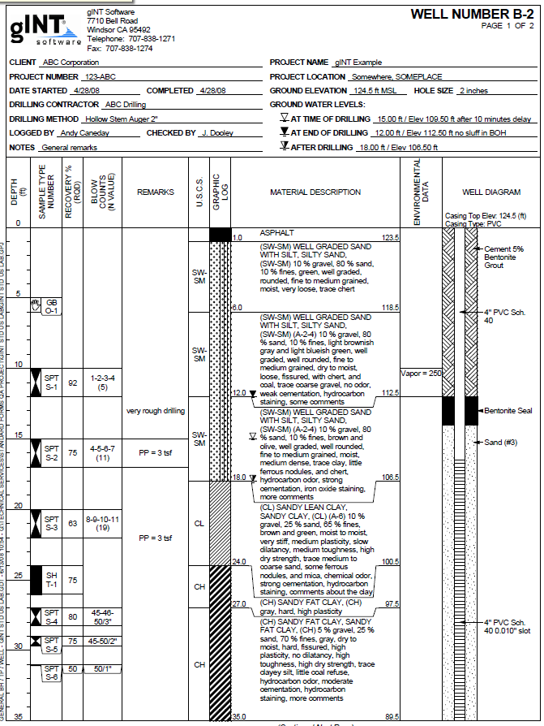
Traditional Geotechnical State of Practice : Report Driven
Report Driven
  Paper based
    (digital paper, PDF)
  Lag between drilling and report generation
    (months)
  Low reusability/manual data re-entry
  End game is the report delivery
Notes:
Report driven
Paper based (digital paper, PDF)
Lag between drilling and report generation (months)
Low reusability/manual data re-entry
End game is the report delivery , no data flow

Slide 6


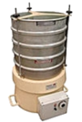
Unmanaged Data Approach
Data is scattered throughout the organization
Multiple data sources and multiple formats (paper, excel, etc.)
  Field monitoring data and collection (handheld devices), lab Information, geophysics, environmental, hydrological, and more
User must perform extensive manual validation
Data redundancies
  Entered three different times for three different reports (borehole, section, lab report)
Lack of interoperability with other software (GIS, Civil, etc.)
Scalability issue
“Manageable” as long as the end game is the report
Notes:
KWA - Unmanaged Data Approach : State?? Not sure what "State" is. State of Practice? I'd suggest just getting rid of it.
Without considering geotechnical data as a resource to be managed, geotechnical engineers often are isolated: internally they
spend hours creating a ‘final report’
Spend hours searching for data used on previous investigations that can be helpful on a current investigations
Have data for a single project scattered across excel sheets, word documents, and even PDFs printed out or saved on a computer.
Must spend hours to check calculations and validate analyses.
Enter data multiple times for different reasons: reports, summaries, and analyses
and need to re-enter data manually to use other design and evaluation applications.
As the report author, I can go around get what I need, copy paste, re enter data, do some formatting and some data validation, and then I get my report, piece of paper and I am done

Slide 7
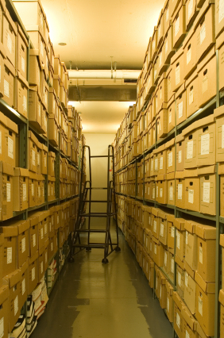
Unmanaged Data Approach : Comments
  “Some of my geotechnical data is in an user-defined database and some in Excel files, and some even on paper”.
  “We use different software for collecting data, another for lab testing and another for reporting”.
  “We require different reports: numerical and graphical, for what sometimes we need to reenter data”.
  “I take as few boring jobs as I can as it is tedious to draw logs manually ”.
Notes:
“Geotechnical data management” is not often a term heard or considered in the geotechnical world. The end product for a geo-professional is a report. Typically a log. But is it? A geotechnical investigation is often the first step in infrastructure. It is the basis for all design and what is possible: foundations for buildings and retaining walls, retaining wall structures, pavement design for roads, flooring design, and even drainage design. The data geo professionals find is necessary for all infrastructure.
Even considering ‘just’ a geotechnical report: it is truly a complex product with vital information. It contains graphics, descriptions, calculations and even diagrams. It is from this ‘standard’ report that much of the world’s infrastructure is constructed. And it’s creation can take hours for a single log.

Slide 8
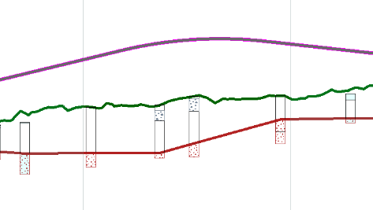
  Subsurface Interpretation and Liability
Civil profile
Geotechnical Models:
Created from local point data
For large areas
High level of unknown
Interpretation difficulty depending on geology
“Partial survey”
Surprises !
Existing ground
Interpretation 1
Interpretation 2
Notes:
KWA - when going through slides, Interpretation 2 (the line) shows up with Interp 1, but nothing else. So the Interpretation line 2 is hanging out in white space, all alone.
A geotechnical model created across large areas is typically generated with relatively distinct point data information from the boreholes, meaning large assumptions and extrapolations are made in developing the model.
Soil borings are taken along the project, but at predetermined intervals based on spacing rather than actual ground conditions. For example, a typical roadway project may require soil borings every 150 - 500 feet (give or take, depending on the project) just along the centerline of construction, or a soil boring at a foundation location.

Slide 9
  Traditional Geotechnical State of Practice and BIM
Geotechnical subsurface data stored in “paper format” or multiple sources
No single source of truth that can be queried by other systems
Subsurface interpretation

Slide 10
  Including Geotechnical Data in to BIM
Notes:
A geotechnical model created across large areas is typically generated with relatively distinct point data information from the boreholes, meaning large assumptions and extrapolations are made in developing the model.
Soil borings are taken along the project, but at predetermined intervals based on spacing rather than actual ground conditions. For example, a typical roadway project may require soil borings every 150 - 500 feet (give or take, depending on the project) just along the centerline of construction, or a soil boring at a foundation location.

Slide 11


Digital Data : Centralized Database
  For data storage
  For data validation
  For data querying
  For data reporting
  Data sharing with other programs
  Can be supported by interoperability standards (DIGGS, AGS4)
Need for a single source of truth : one data store, many uses
Notes:
KWA DIGGS - all capital letters (made the change already)
gINT was created in response to the need for a geotechnical software application to manage and report subsurface data. gINT’s unique database driven format enables geo professionals to do so much more than reporting while making reporting simple and direct.
The database format allows for simple data entry and data import from any data structure.
Users can add in validation tools to help catch errors in the database. For example, one could add in rules to prevent sample depths below the bottom lithology description. Or prevent a soil description that cannot exist such as a very loose clay.
Provided data templates are just the start. gINT can manage all subsurface data. This means it is the single source of truth for a geotechnical organization and all users can use it for their work and analysis. Personnel know where to go to get the information they need.
Enter data one time in the database, and use it in several reports. This saves time and effort and minimized potential for data entry errors.
Reports can be customized to your organization. You can create an organizational standard for all personnel to use. This can also minimize liability as you know what is on each log, and the format is approved.
gINT’s database format enables other applications to reach in to gINT to read data directly, or data can be exported from gINT and imported in a necessary format for other applications to easily read.

Slide 12
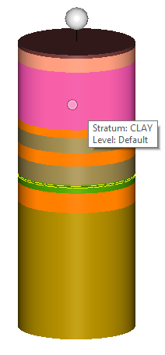
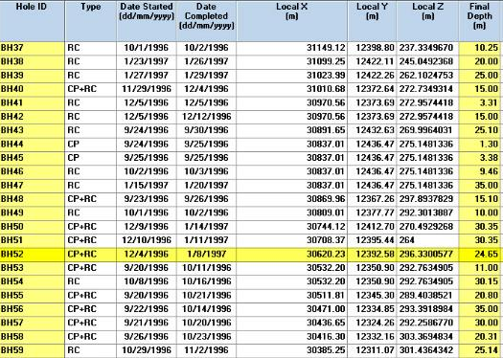
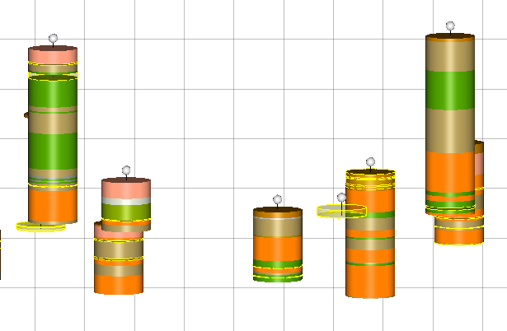
Digital Data: Paper to Database, Database to Models

Slide 13
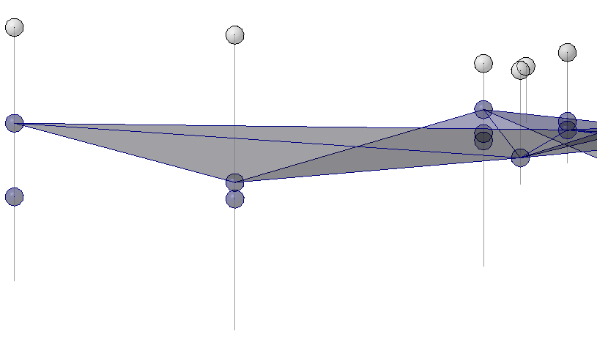
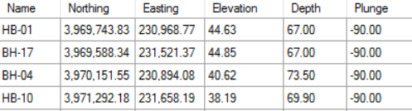
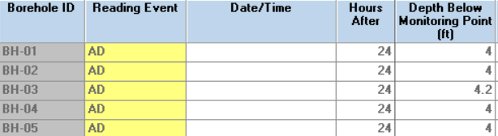
Database to Models :
A geotechnical database is a “geospatial database”
X, Y, Z (ground) + depth
Water level depth

Slide 14
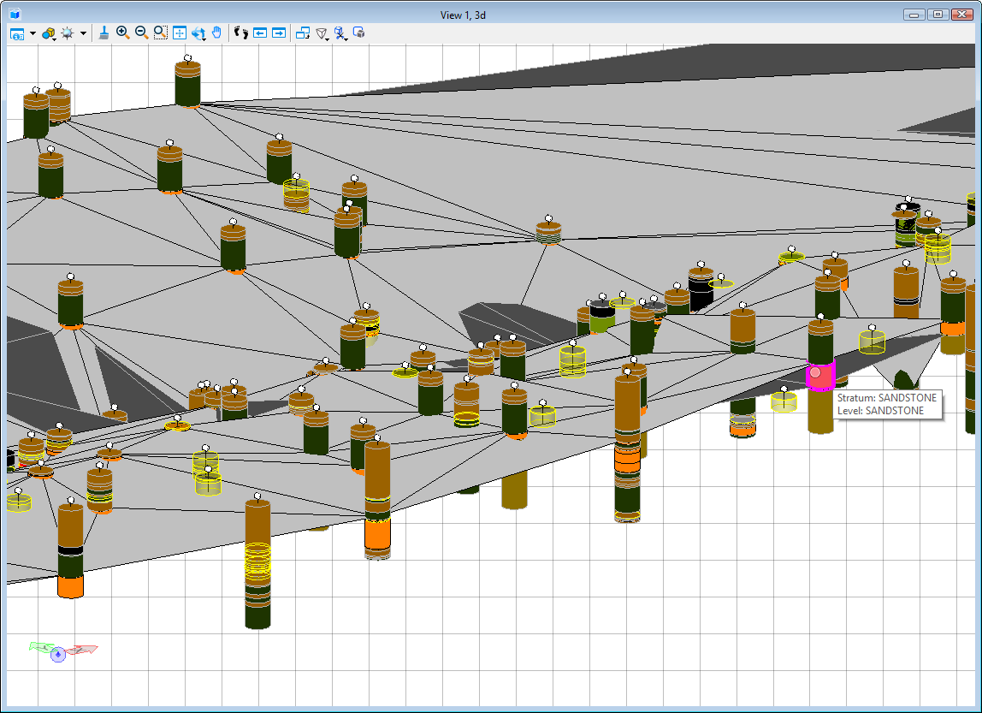
Displaying Geotechnical Models in Context
Need for geo coordination tools
  Local project
  GPS
  Station-offsets
  On the Fly Reprojection

Slide 15
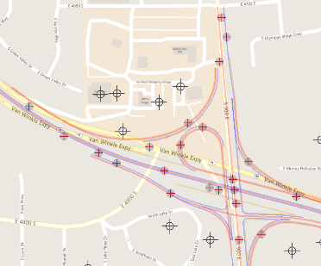
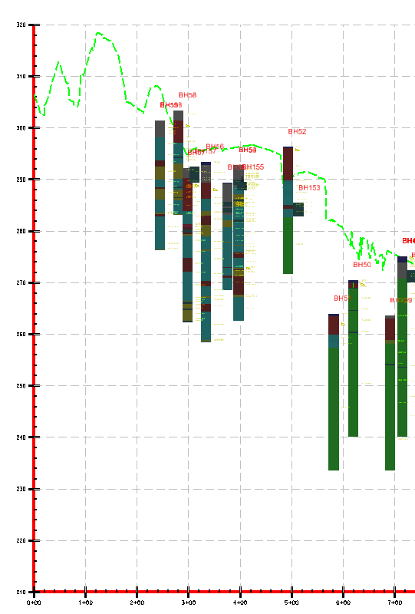
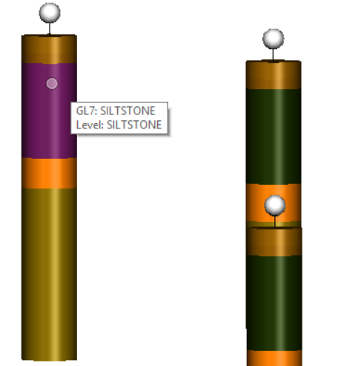
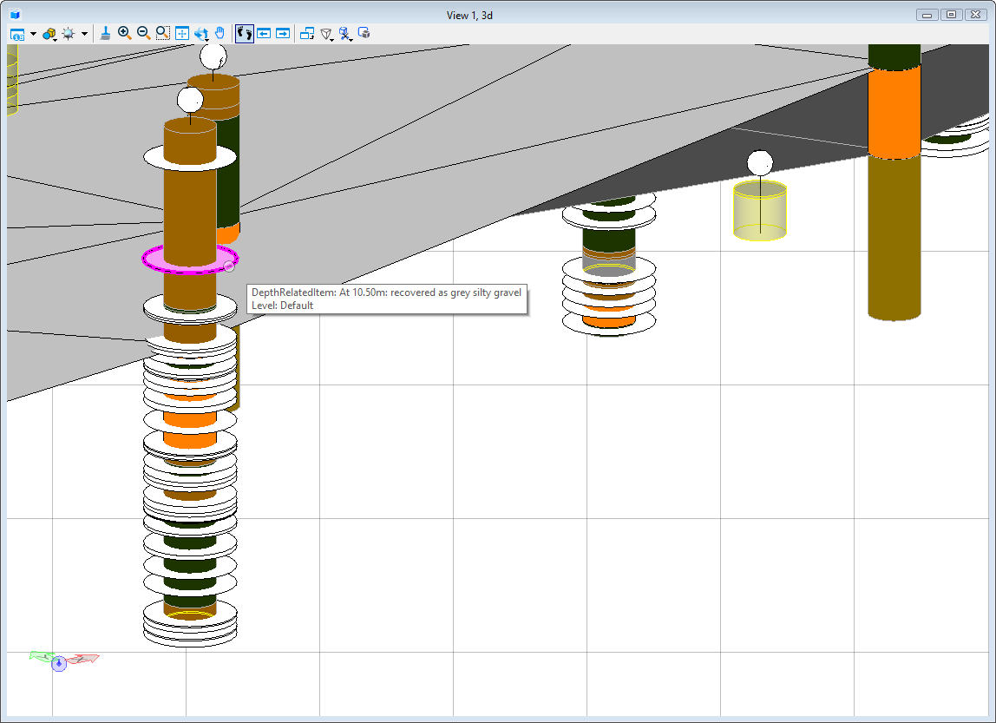
Displaying Geotechnical Models in Context
Geotechnical database
output :
  2d plans
  Profiles
  3d models
  Subsurfaces
Notes:
KWA: 1-1 profiles? Profiles are usually scaled 10:1 (H:V) as they are more paper space. 1-1 makes little sense in the practical world. Unless you are going somewhere with this. I would leave it as "Profiles". No adjectives

Slide 16
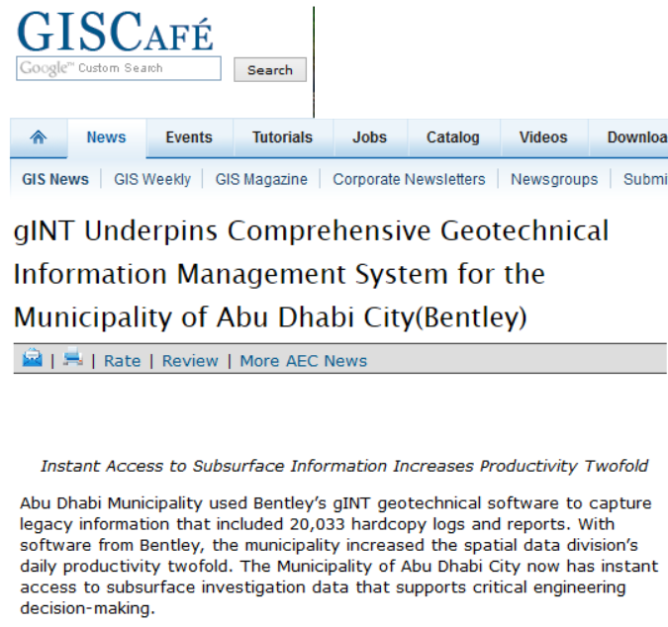
2d plans
Single Source of truth and centralized geotechnical data enable data flow to GIS
Notes:
The Municipality of Abu Dhabi City ensures sustainable development and enhances the quality of life for the Emirate of Abu Dhabi, United Arab Emirates. The Municipality routinely commissions and manages projects where large volumes of data from site investigation and design are archived and accessed by internal and external users. Using a geotechnical database software application and web mapping, the Municipality’s Spatial Data Division developed the Geotechnical Information Management System (GIMS) as a comprehensive geotechnical database and information system for quick access to all geotechnical data. Providing instant access to subsurface investigation data supports rapid decision-making and appropriate resource allocation, thereby saving time and money.
GIS integration allows access to the existing geotechnical data at any time, from anywhere, via the Internet or the Municipality’s intranet. The robust geotechnical data submission standards ensure the uniformity and quality of data that is submitted. The streamlined data management processes using a standard geotechnical database improved the Spatial Data Division’s daily productivity twofold.

Slide 17
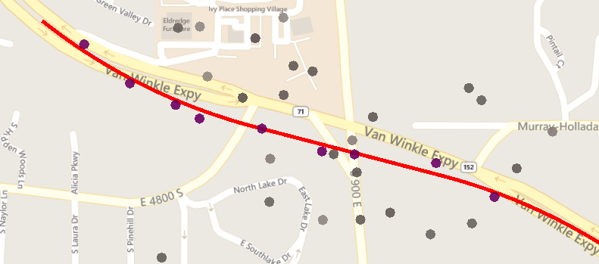
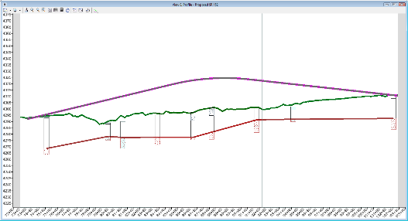
Profile Views
Dynamic profiles
Borehole visualization plus surfaces
Civil projects
Surface interpretation
“Browsing” tool for subsurface data
Notes:
KWA - Again, suggest no 1-1 (and if you do, 1:1). Unless you are making a point about an improvement to the state of practice. Not sure if you are.

Slide 18
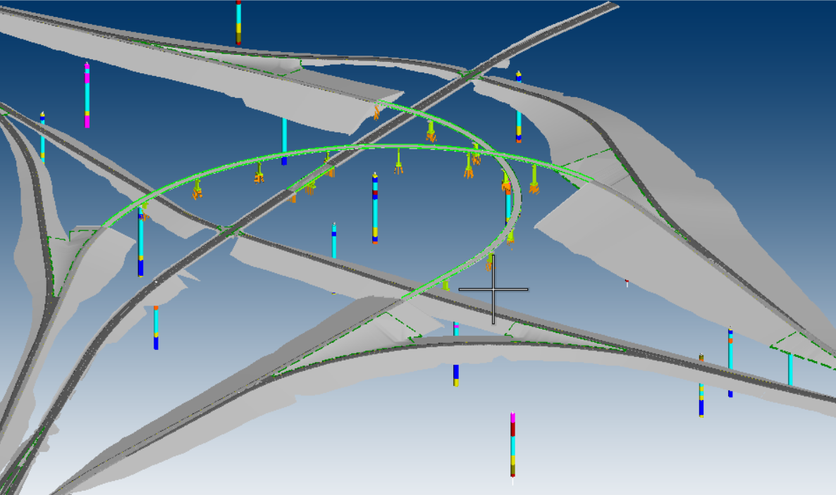
3d Models : Use of geotechnical data in infrastructure projects
End game is the infrastructure design and construction
Terrain
3D visualization of geotechnical data
Overlay design plans to provide context view
Data QA/analysis

Slide 19
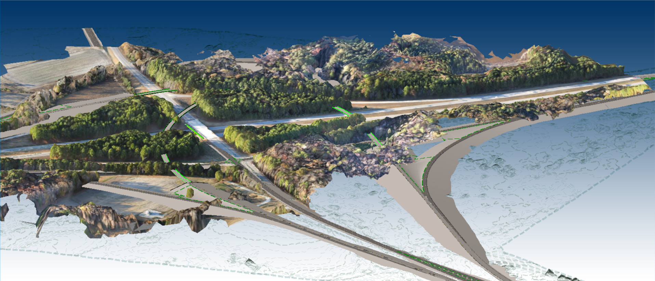

Reality mesh from drones
Terrain survey
Bridge design
Road design
Geotechnical data

Slide 20
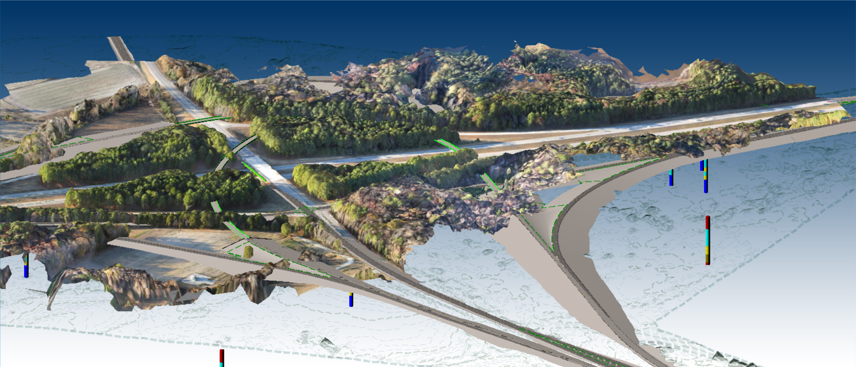
Reality mesh from drones
Terrain survey
Bridge design
Road design
Geotechnical data

Slide 21
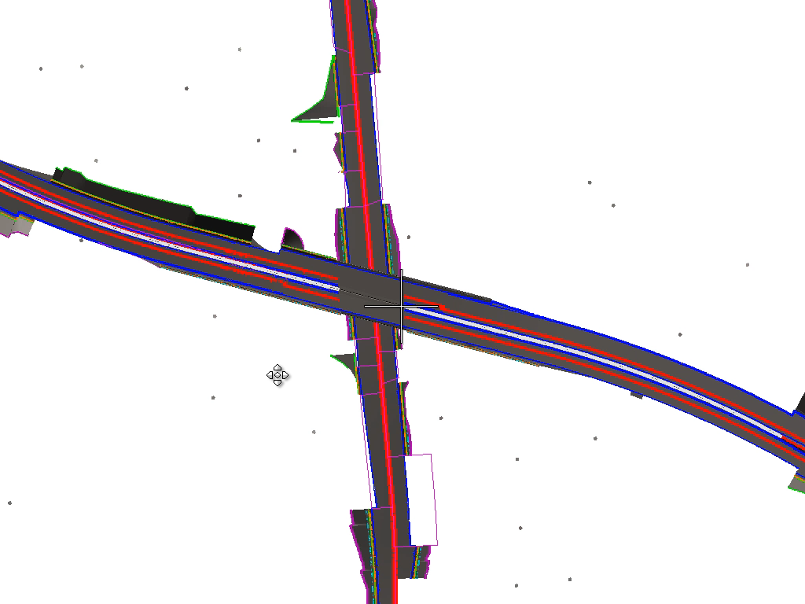
Subsurface : Layer Creation for BIM
Subsurfaces needed for civil projects
Gradual process
“Imperfect interpretation” or “paper logs”

Slide 22
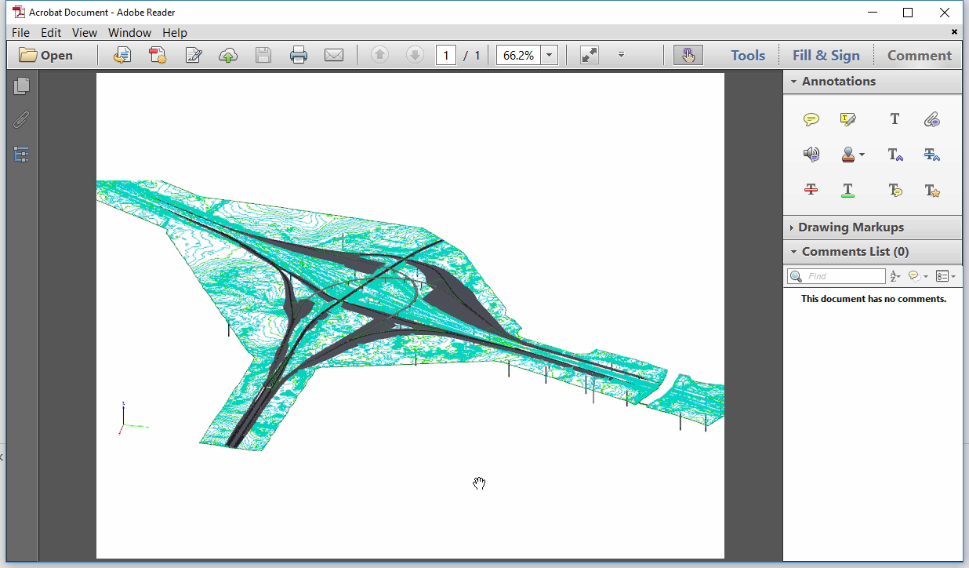
An Example ….

Slide 23
Conclusion
Geotechnical data can be stored in systems that are open for multiple uses rather than “just” the generation of a paper based reports.
Using a single source of truth will address 2 of the 3 issues identified in the traditional geotechnical state of practice : report driven and unmanaged data .
The liability/surprise aspect of the subsurface generation/interpretation remains, it is a major point to be addressed in order to fully deploy BIM workflows.
Notes:
Again...liability thoughts?

Slide 24
Thank You
Questions ?

